Slide 1

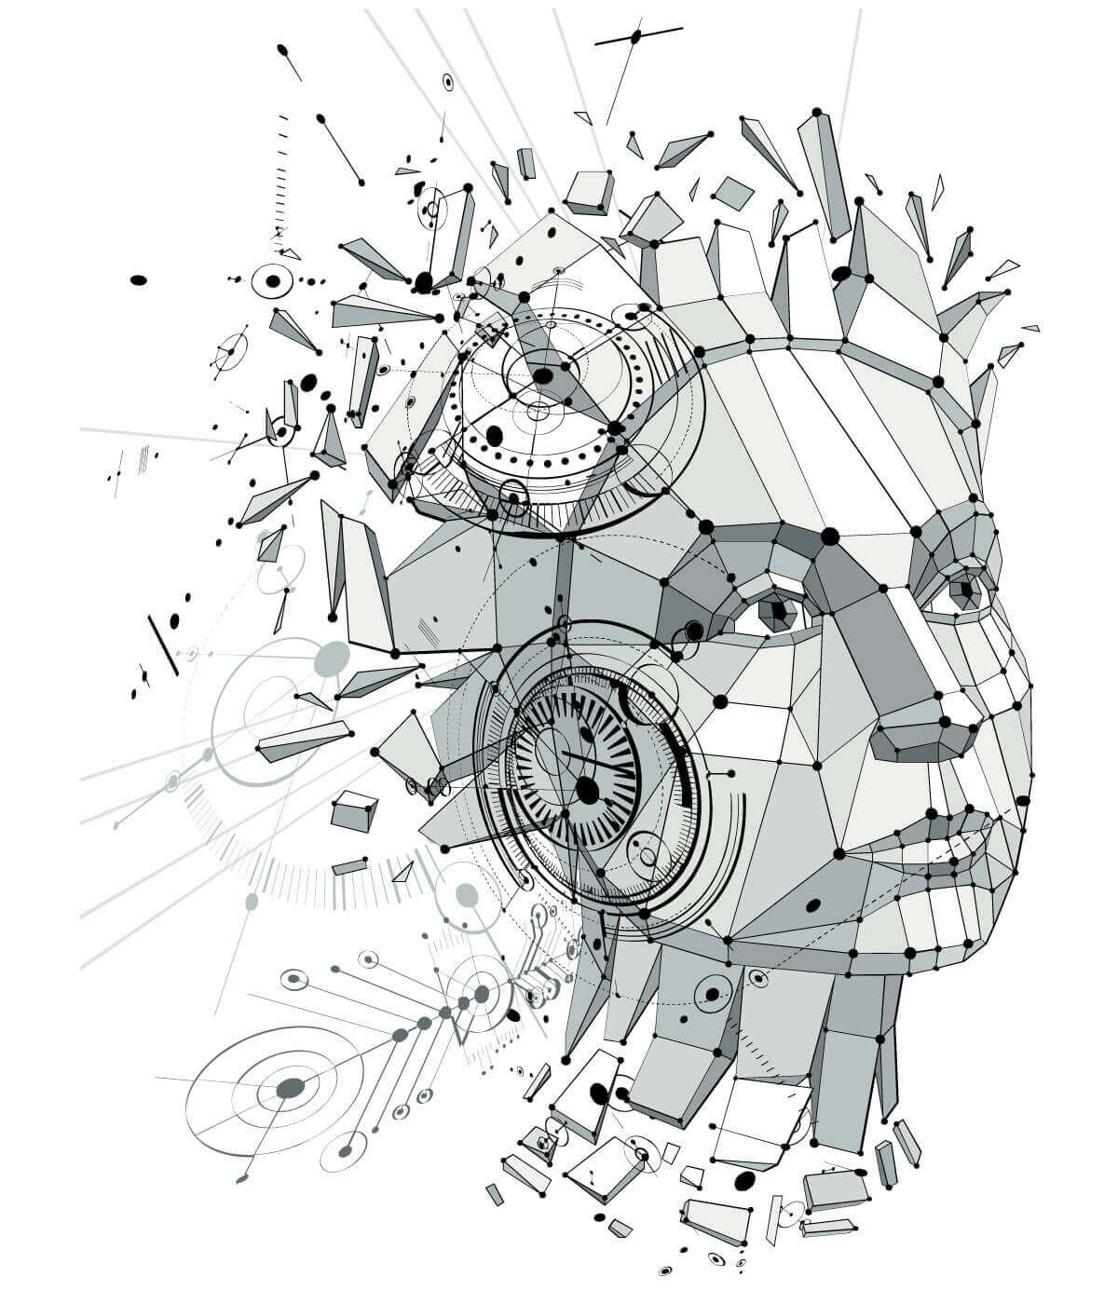
The History Of Women In Technology
-Hendrietta Dube

Slide 2

What I will talk about
Women's fight to work/rights
Women that made a change in the technology and computer science industry
Women in Technology today

Slide 3
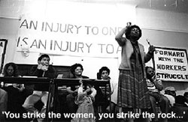
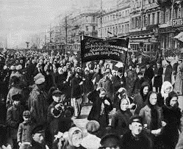
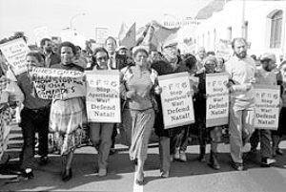
The fight for rights/Work
1956-South Africa
1869 -United Kingdom
1854-United States Of America

Slide 4


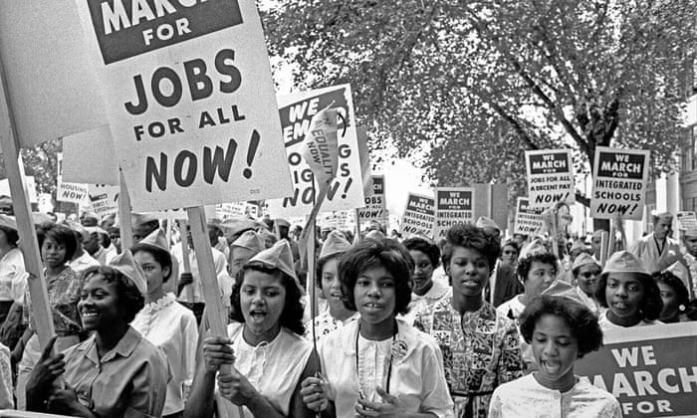

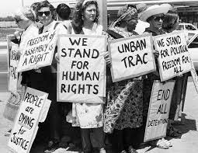
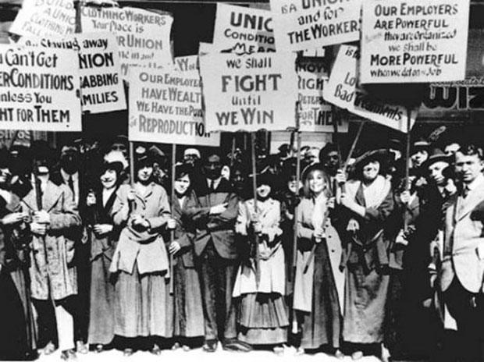
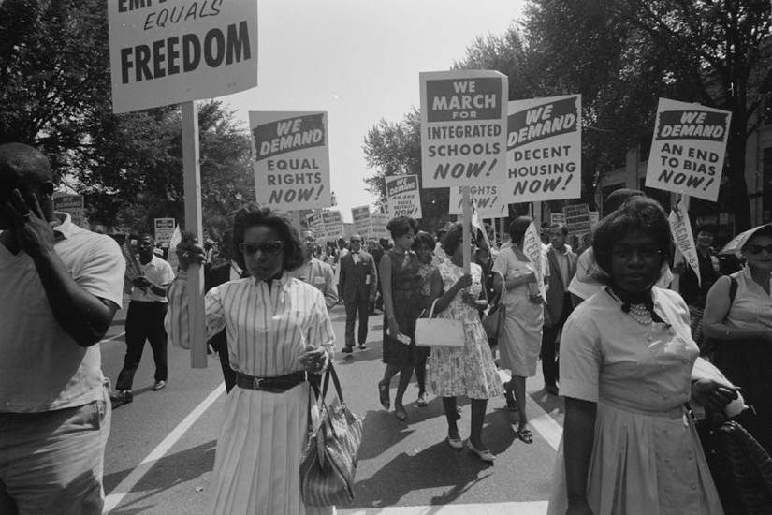


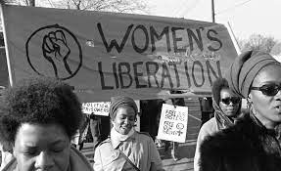
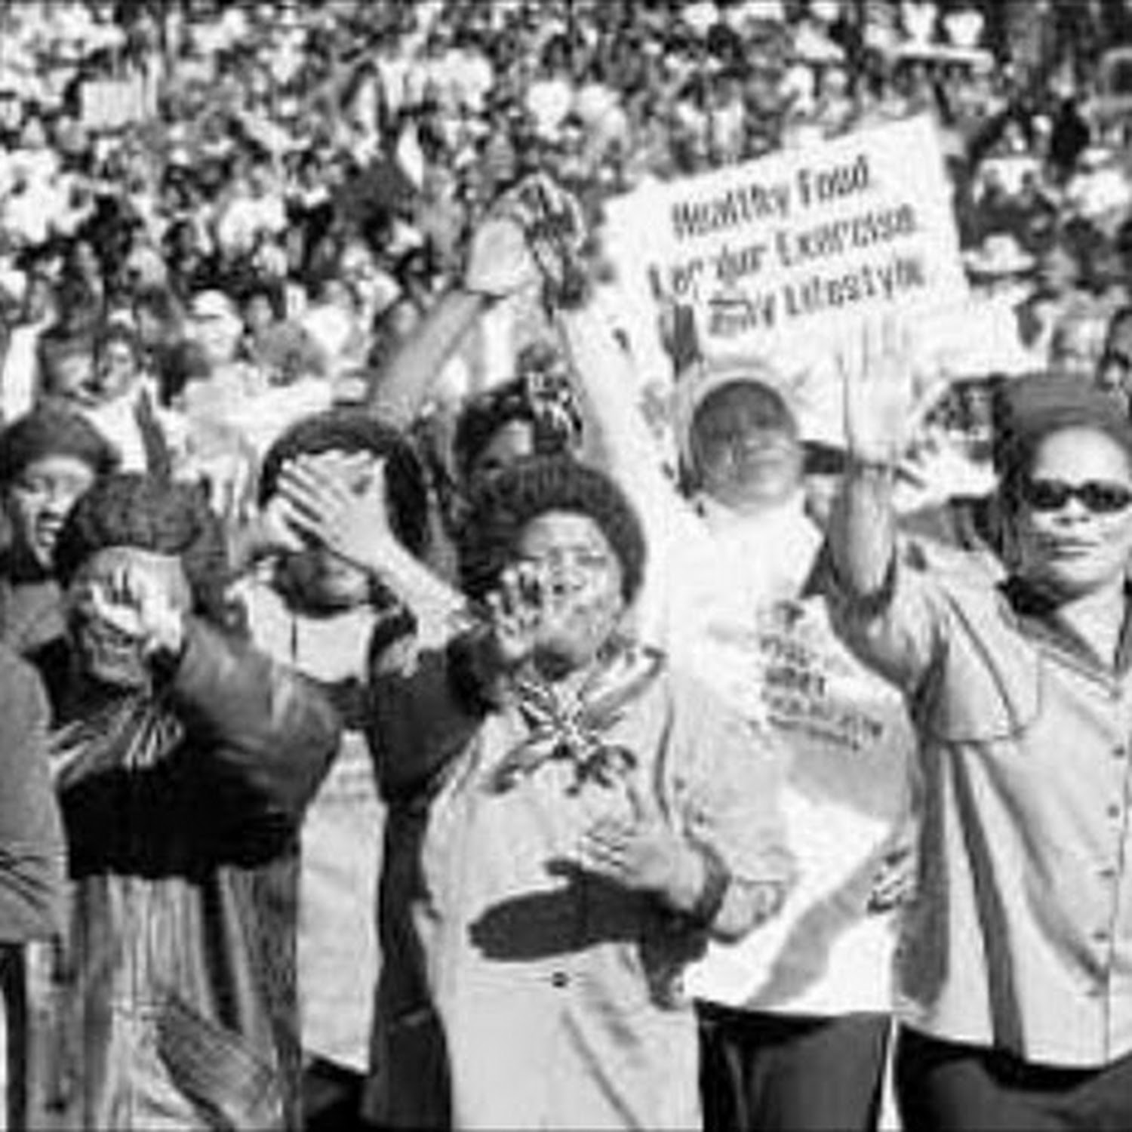

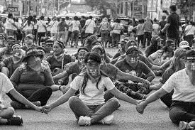


Why Do We Celebrate Women's Day

Slide 5
Women In Technology

Slide 6
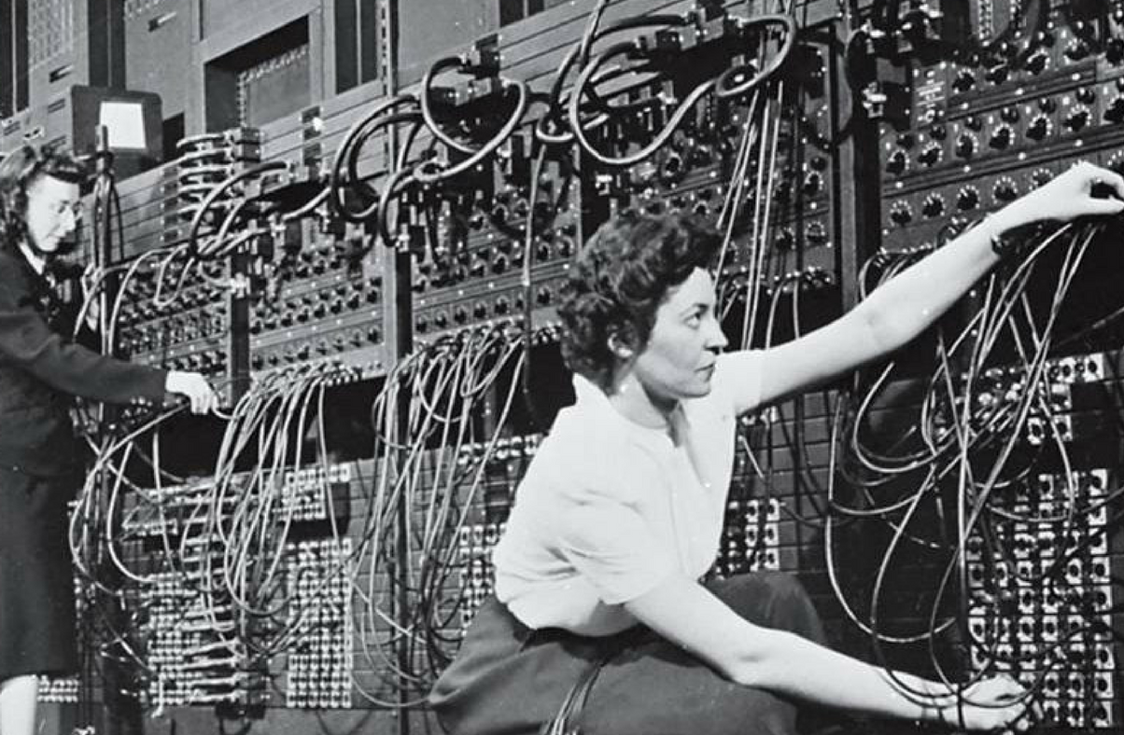
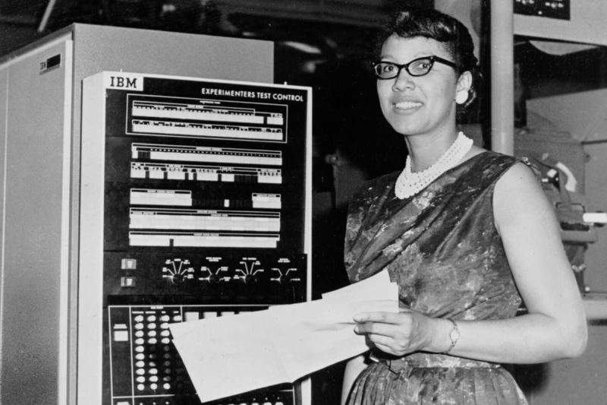
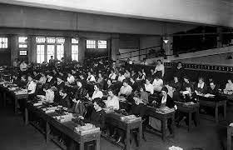
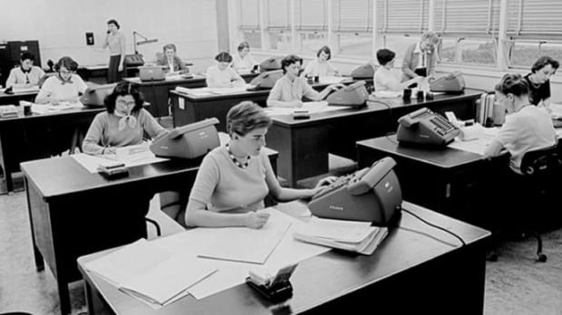
“Human Computers”

Slide 7
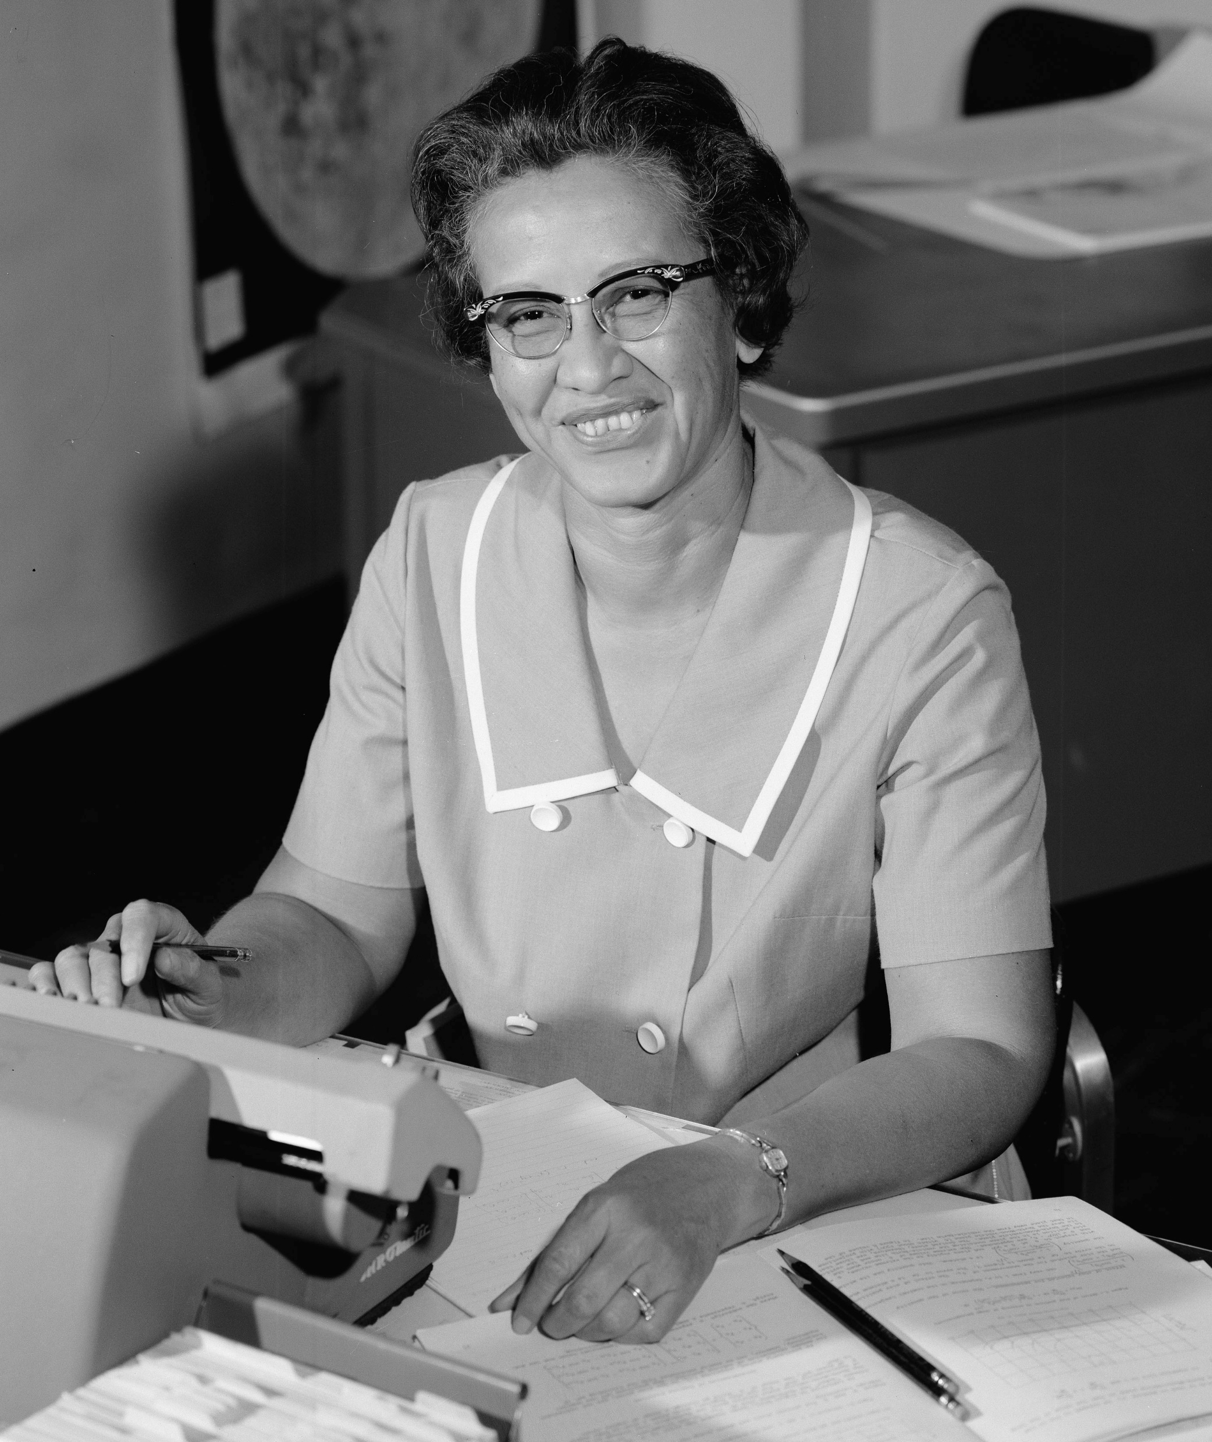
Katherine Johnson
Katherine Johnson, an African American NASA employee, mathematician and physicist, in 1966
In 1958, after NACA was reformulated into the National Aeronautics and Space Administration (NASA), Johnson was among the people charged with determining how to get a human into space and back. The following year she remarried, to decorated Navy and Army officer James A. Johnson.
Katherine Johnson was a mathematician who worked as a “computer” at NASA. Her calculations allowed for astronaut John Glenn to successfully orbit around the Earth in 1962. Another central figure who worked alongside her during the computations was Dorothy Vaughn, NASA’s first African American manager.

Slide 8
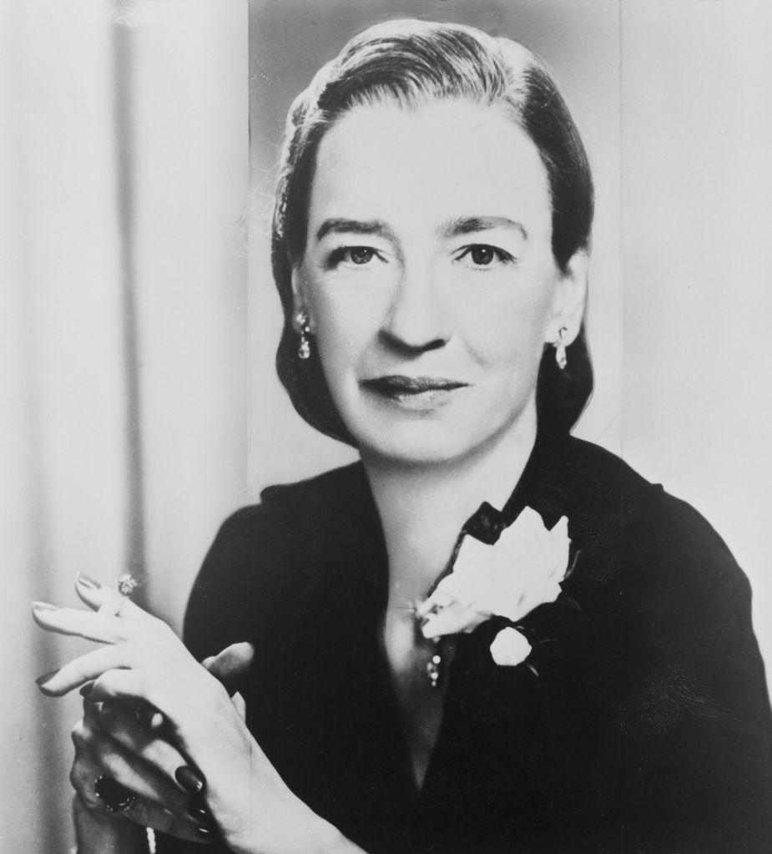
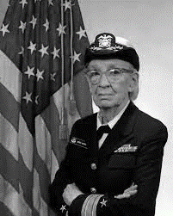
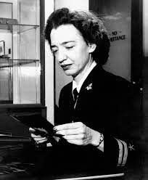
Dr Grace Hopper

Slide 9
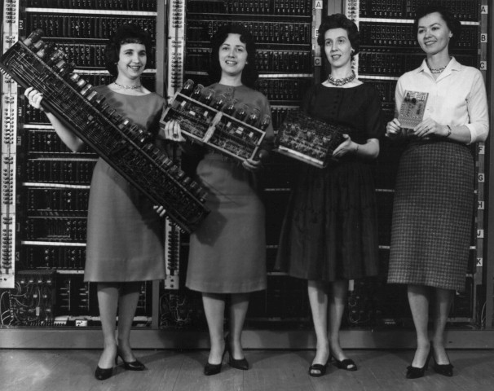
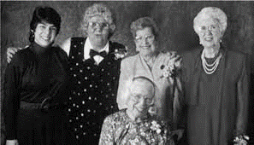
The Women of ENIAC
Fran Bilas, Betty Jennings, Ruth Lichterman, Kay McNulty, Betty Snyder, and Marlyn Wescoff

Slide 10










Organisations Advancing
Women Into Technology

Slide 11



THANK YOU

